Slide 1
Sexual Intercourse and Birth
Year 11 Human Biology
ATAR
PowerPoint #19

Slide 2
SCSA Syllabus Reference
for the establishment of a pregnancy, conception requires the union of viable sperm and ovum at the optimal time in the ovarian cycle
the development of the embryo after implantation involves the differentiation of cells into three different germ layers that will eventually produce specific systems in the body and the placenta
the stages of labour include birth, during which there are circulatory system changes in the child

Slide 3
Lesson Intention
To describe the events that occur during sexual intercourse
To describe the events that occur during fertilisation
To explore the early embryonic development and implantation in the human body
To distinguish between the primary germ layers in regards to their structure and function
To describe the development of the placenta

Slide 4
Lesson Intention
To explore the stages and developments that occur during pregnancy
To explain the events that occur during the stages of labour
To discuss the health and changes of baby and mother during and after pregnancy

Slide 5
Success Criteria
describe the events that occur during sexual intercourse
describe the pathway taken by sperm during sexual intercourse
describe the structure of a secondary oocyte
describe the events that occur during fertilisation
describe the process of blastocyst formation
describe the process of implantation
describe the process of hormone production
describe the process of cell differentiation

Slide 6
Success Criteria
recall the structures formed by the three primary germ layers
differentiate between the primary germ layers
describe the development of the placenta
describe the changes from embryo to foetus
describe the changes during foetal development
summarise the main stages of foetal development
summarise the changes the pregnant mothers body undergoes

Slide 7
Success Criteria
describe the events prior to labour
describe the events that occur during the three stages of labour
describe the changes in the baby at birth
describe the changes to the mother after birth
explain actions that help to maintain a healthy pregnancy
explain actions that can harm a pregnancy and foetal development

Slide 8
Vocabulary
Sexual intercourse: the sex act during which gametes are passed from the male to the female
Erection: the penis in a state of sexual excitation
Ejaculation: muscular contractions that propel semen from the penis
Semen: the liquid that nourishes and aids the transport of sperm; also called seminal fluid

Slide 9
Vocabulary
Orgasm: the climax of sexual intercourse
Insemination: the deposition of sperm within the vagina
Sperm mortality: the death rate of sperm
Corona radiata: the innermost layer of cells surrounding the egg

Slide 10
Vocabulary
Zona pellucida: the thick glycoprotein membrane surrounding the plasma membrane of the ovum
Acrosomal reaction: the release of enzymes from the acrosome when the spermatozoa fuse with the ovum
Pronucleus: the nucleus of the ovum (female pronucleus) and of the sperm (male pronucleus) that fuse at fertilisation

Slide 11
Vocabulary
Zygote: the fertilised ovum from which a new individual develops
Blastocyst: a hollow ball of cells formed during early embryonic development
Embryoblast: the group of cells in the blastocyst that develop into the embryo

Slide 12
Vocabulary
Embryo: the early stage of development of an organism; in humans, from fertilisation to the end of the eighth week of pregnancy
Implantation: the process whereby an embryo sinks into the lining of the uterus
Foetus: the developing individual after the second month of pregnancy
Proliferation: the process by which cells replicate themselves

Slide 13
Vocabulary
Gene: the factor that determines a hereditary characteristic; part of a chromosome
Ectoderm: the outer tissue layer of the embryo; it gives rise to the outer covering of the body
Mesoderm: the middle tissue layer of an embryo; it gives rise to the muscles, connective tissues and the alimentary canal

Slide 14
Vocabulary
Endoderm: the inner tissue layer of the embryo; it gives rise to the lining of the digestive tract and the glands associated with it, as well as to the respiratory tract and parts of the excretory and reproductive systems.
Amniotic fluid: the fluid contained within the amnion; it protects the embryo against injury

Slide 15
Vocabulary
Amnion: the membrane that forms a cavity around the embryo; it secretes a fluid (amniotic fluid) into the cavity to protect the embryo
Chorion: one of the embryonic membranes that eventually forms part of the placenta
Placenta: the organ that supplies nutrients to, and removes wastes from, the foetus; it also produces a number of hormones, including oestrogen and progesterone

Slide 16
Vocabulary
Chorionic villi: finger-like projections that develop from the outer layer of cells of the early embryo, they grow to form part of the placenta
Umbilical cord: the cord that attaches the foetus to the placenta
Umbilical vein: a single vein within the umbilical cord that carries blood from the placenta to the foetus

Slide 17
Vocabulary
Umbilical arteries: two arteries within the umbilical cord
Gestation: the period of development of an organism in the uterus; the time between conception and birth
Parturition: the process of birth
Labour: the sequence of events that precede birth and result in the expulsion of the foetus through the vagina

Slide 18
Vocabulary
Birth canal: the passage formed by the uterus, he dilated cervix and the vagina, through which the foetus travels at birth
Stage of expulsion: the second stage of labour, from full dilation of the cervix to birth
Umbilicus: the small scar on the abdomen that makes the former attachment of the umbilical cord to the foetus; commonly called the navel

Slide 19
Vocabulary
Afterbirth: the placenta, and the remains of the umbilical cord, amnion and chorion; it is expelled shortly after the birth of a baby
Ductus venosus: the foetal blood vessel that enables blood to bypass the liver.
Ductus arteriosus: the foetal blood vessel that enables blood in the pulmonary artery to bypass the lungs and flow directly into the aorta

Slide 20
Vocabulary
Foramen ovale: an opening between the atria of the foetal heart; it allows blood to flow directly from the right atrium into the left atrium
Teratogen: an agent that causes physical defects in a developing foetus

Slide 21
Sexual Intercourse
Sperm is deposited into the vagina by an erect penis.
Ejaculation propels semen containing sperm into the vagina during an orgasm. Usually the ejaculation contains 250-300 million sperm.
A female climax increases the secretion of cervical mucus and muscle contractions.

Slide 22
Fertilisation
When the male ejaculates, the sperm are released in the vagina in a process called insemination.
The sperm reach the upper portions of the uterine tube in minutes, due to help from muscular contractions from the female.

Slide 23
Sperm Death
Of the hundreds of millions of sperm deposited into the vagina, only a few thousand will reach the uterine tube.
The death of sperm is called sperm mortality and is usually very high.
THE GREAT SPERM RACE!

Slide 24
Fertilisation
Fertilisation occurs in the uterine tube.
The secondary oocyte that is released at ovulation is at metaphase II. It is surrounded by the outer corona radiata (consists of follicle cells held together by cementing materials that contain acid) and the inner zona pellucida (a glycoprotein matrix surrounding the plasma membrane of the oocyte)

Slide 25
Fertilisation continued
Once the sperm is through the corona radiata, it encounters the zona pellucida. This causes digestive enzymes to be released, breaking down the glycoprotein matrix, giving the sperm access to the plasma membrane.
When the plasma membranes of the oocyte and spermatozoa fuse, the nucleus of the sperm enters the ovum.

Slide 26
Fertilisation continued.
The entrance of one sperm into the secondary oocyte stimulates the formation of a fertilisation membrane around the oocyte, which prevents the entrance of any more sperm. This ensures that only one haploid set of chromosomes joins the chromosomes of the oocyte.
Once the sperm has entered the oocyte the tail is absorbed, and the head begins to move through the cytoplasm in the form of a male pronucleus- the haploid nucleus of the sperm.

Slide 27
Fertilisation continued.
The entrance of the sperm stimulates the secondary oocyte to complete the second meiotic division. The nucleus of the oocyte develops into a female pronucleus, which fuses with the male pronucleus to form a single nucleus that how has the diploid number of chromosomes.
Fertilisation is complete, and the fertilised oocyte is now called a zygote.

Slide 28
Blastocyst Formation
The zygote travels down the uterine tube and begins to divide by mitosis.
By the end of approximately 6 days following fertilisation, the original zygote has reached the uterus and developed into a blastocyst (hollow ball of cells that surround a fluid filled cavity).

Slide 29
Blastocyst Formation continued.
At one side of the cavity is a group of 30 cells called the inner cell mass (composed of stem cells that will differentiate into the different body cells to form the embryo).

Slide 30
Implantation
The blastocyst remains free within the cavity of the uterus for 2-3 days.
It then sinks into the endometrium to become firmly attached to the wall of the uterus (implantation), enabling the blastocyst to gain nourishment.

Slide 31
Hormone Production
The continued development of the blastocyst depends on the endometrium being maintained. High levels of oestrogen and progesterone in the blood prevent the endometrium breaking down and the menstrual cycle ceases.
During the early stages of pregnancy, the corpus luteum produces needed hormones. The placenta takes over at 8-12 weeks.

Slide 32
Embryonic Period
The first two months of pregnancy are referred to as the embryonic period.
After the second month, the developing individual is called a foetus.

Slide 33
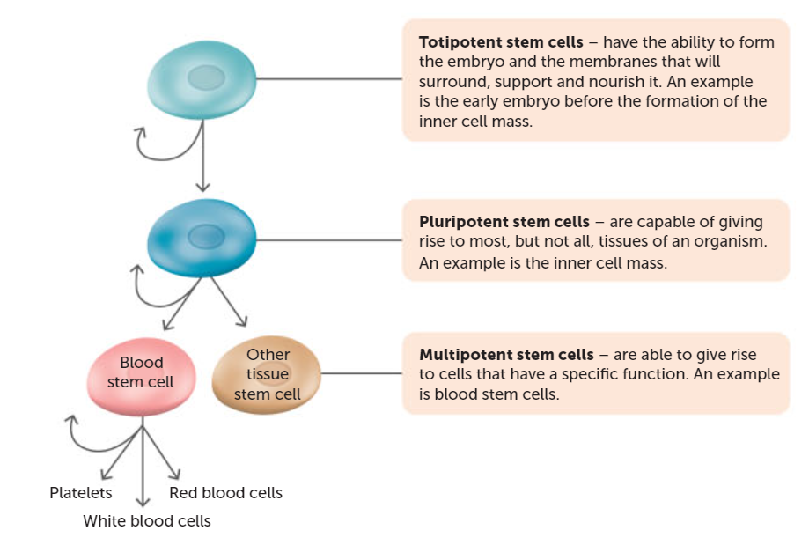
Cell Differentiation
The cells that make up the inner cell mass of the blastocyst are stem cells.
A zygote develops from an unspecialised totipotent cell to a blastocyst, and then to an embryo and its membranes.

Slide 34
Primary Germ Layers
While the blastocyst is implanting in the lining of the uterus, the inner cell mass undergoes changes as the cells change to multipotent. This process results in the formation of three layers of cells (primary germ layers).

Slide 35
Ectoderm
The ectoderm is the outermost germ layer.
This will form the outer layers of the body such as the skin, hair and mammary glands, as well as the nervous tissue.

Slide 36
Mesoderm
The mesoderm is the middle germ layer.
The skeleton, muscles, connective tissue, heart, blood, and urogenital tract form from the mesoderm.
The mesoderm also allows the formation of the stomach and intestines.

Slide 37
Endoderm
The endoderm is the innermost germ layer
It forms the lining of the digestive syste, as well as the lungs and thyroid.

Slide 38
Embryonic Membranes
Early in the embryonic period, four embryonic membranes form. These lie outside the embryo and serve to protect and nourish it as it develops.
The amnion is the first membrane to develop. By the 8th day after fertilisation, it surrounds the embryo, enclosing it in a cavity that produces amniotic fluid. The fluid protects the embryo, maintains temperature and assists in embryo movement.

Slide 39
Embryonic Membranes continued.
Another embryonic membrane is the chorion. It is formed from the outer cells of the blastocyst together with a layer of mesodermal cells.
The chorion surrounds the embryo and the other embryonic membranes. As the amnion enlarges, it fuses with the inner layer of the chorion, with the chorion eventually becoming a main part of the foetal portion of the placenta.

Slide 40
Embryonic Membranes continued.
The other two embryonic membranes are the yolk sac and allantois.
These are not as important in humans; however, they do form the outer structure of the umbilical cord.

Slide 41
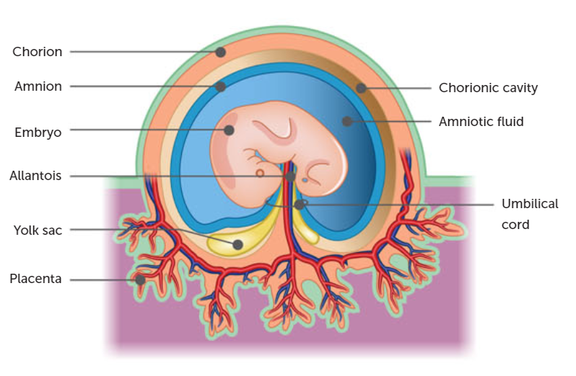

Slide 42
Development of the Placenta
The placenta is an organ that forms from both foetal and maternal tissues during the first three months of gestation, with the foetal portion developing from part of the chorion.
The placenta supplies nutrients to, and removes wastes from, the foetus. It also serves as an endocrine organ, producing a number of the hormones necessary to maintain pregnancy.

Slide 43
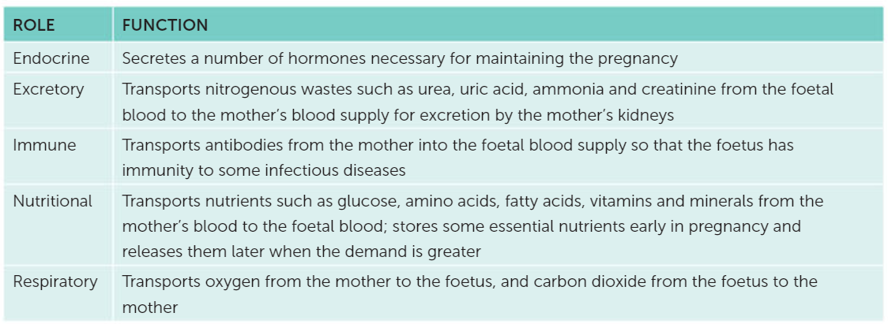
Function of the Placenta

Slide 44
Development of the Placenta continued.
The foetal part of the placenta begins to develop as the blastocyst is implanted in the endometrium. Small branching, finger-like projections called chorionic villi, develop from the chorion and contain numerous blood vessels.
They grow into the endometrium and become surrounded by pools of the mother’s blood (doesn’t mix because of cell layers, but does allow for an exchange of materials via diffusion and active transport).

Slide 45
Development of the Placenta continued.
The placenta is attached to the foetus by the umbilical cord. Inside the umbilical cord are two umbilical arteries that carry blood to the capillaries of the chorionic villi.
A single umbilical vein carries blood from the placenta, through the umbilical cord, back to the foetus. On the maternal side, blood from the mother enters the placenta through the uterine arteries, flows through the blood spaces where the exchange of substances occurs, and leaves again through the uterine veins.

Slide 46
Pregnancy
The period of pregnancy, the time that the embryo or foetus is carried in the uterus, is called gestation.
During this time the child grows to a length of about 50 cm and an average weight of 3400 grams.

Slide 47
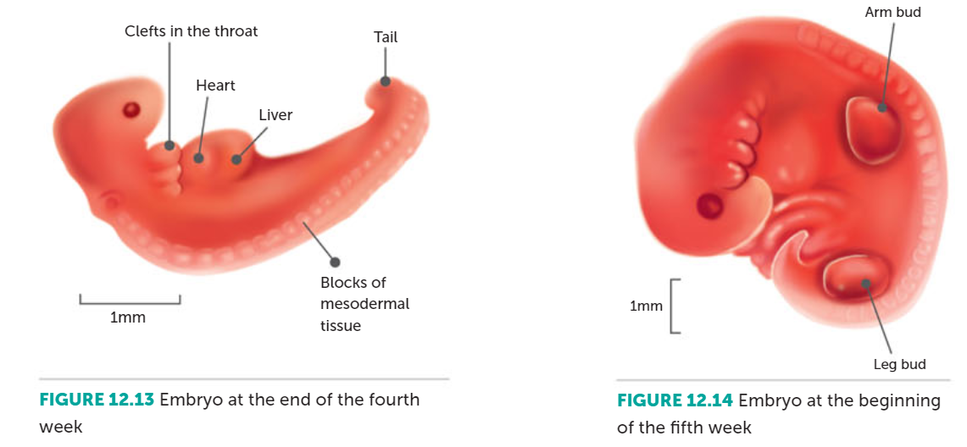
From embryo to foetus
After one month of growth, the embryo is just under 4mm long. The most obvious feature at this stage is the development of muscle segments on either side that will become the brain and spinal cord.

Slide 48
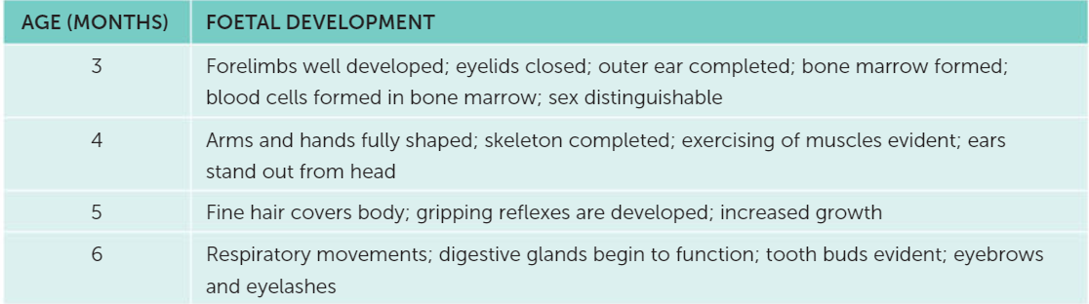
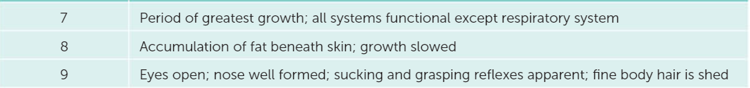
Stages of Foetal Development

Slide 49
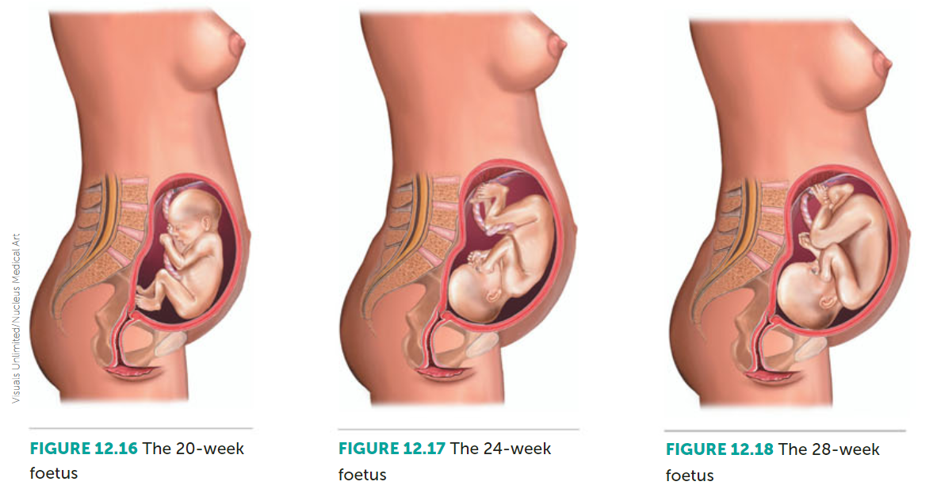

Slide 50
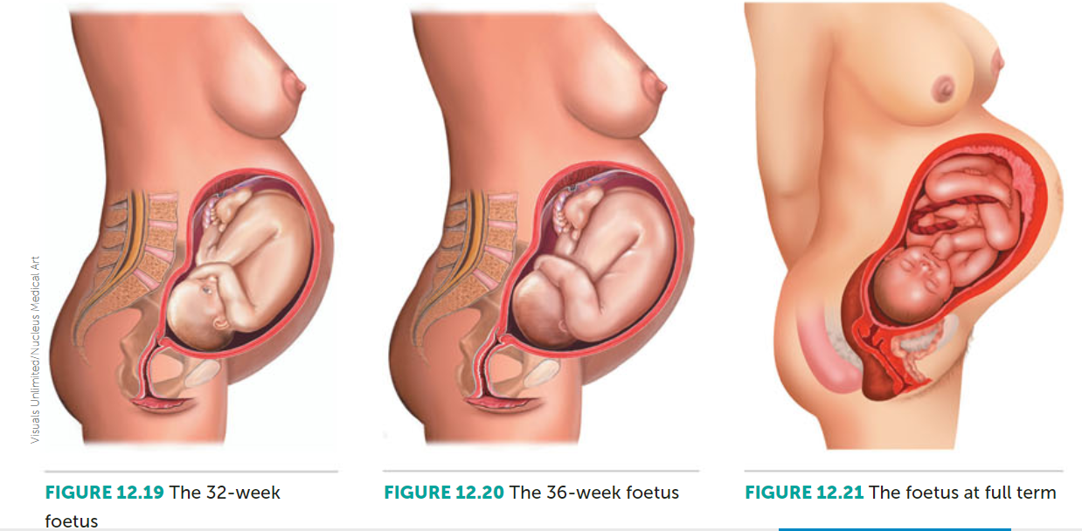

Slide 51
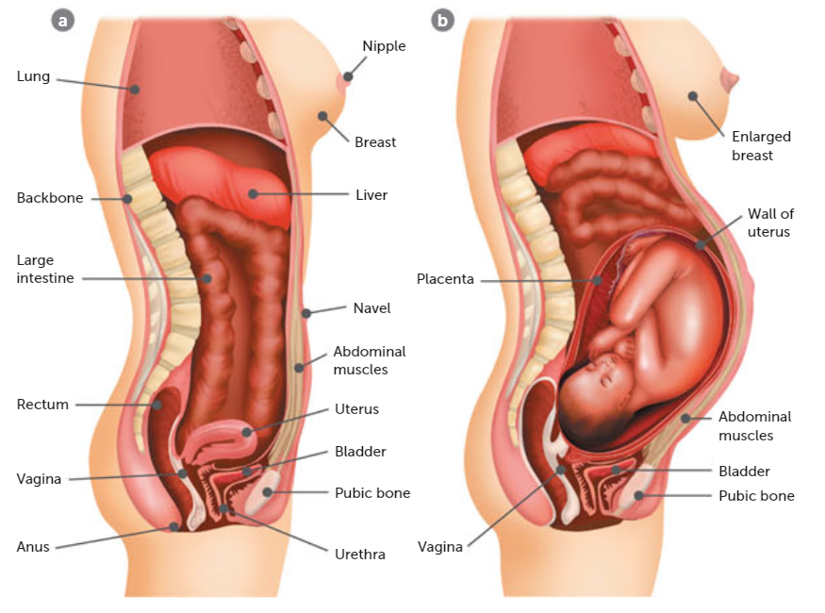
The Pregnant Mother
The most obvious changes to the pregnant women are associated with her growing abdomen.
There is an increase in the size of the heart and in blood volume. This is to cater for the extra blood that is flowing through the placenta.
The greater blood volume results in an increased blood flow to the kidneys and, therefore, increased urine production.
Emotional state may be affected due to hormones.

Slide 52
Changes during birth
The process by which the foetus is expelled from the mother’s body at the end of gestation is called birth, or parturition.
Prior to labour: hormonal changes cause the ligaments of the pelvis to soften, and increase the response of the uterus to stimuli and strengthen the contraction of its muscles. The head of the foetus will rest against the mother’s pelvis. The cervix has softened, shortened in length and is likely to have begun to open a little.

Slide 53
Changes during birth continued
First stage of labour: Labour pains (frequent contractions) signal the beginning of the birth process. The dilation of the cervix is the time from the onset of labour to the complete dilation of the cervix (8-9 hours).
As the contractions become stronger and more frequent, the head of the foetus is pushed more forcefully against the slowly dilating cervix. Eventually the cervix will be fully dilated (10 cm) and the uterus, cervix and vagina form a single passage called the birth canal.

Slide 54
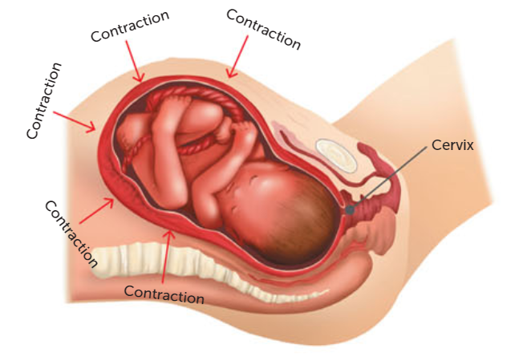

Slide 55
Changes during birth
Second stage of labour: involves the delivery of the foetus and is often called the stage of expulsion. It frequently begins with the bursting of the membrane surrounding the foetus.
Lasts about 20 minutes-2 hours.

Slide 56
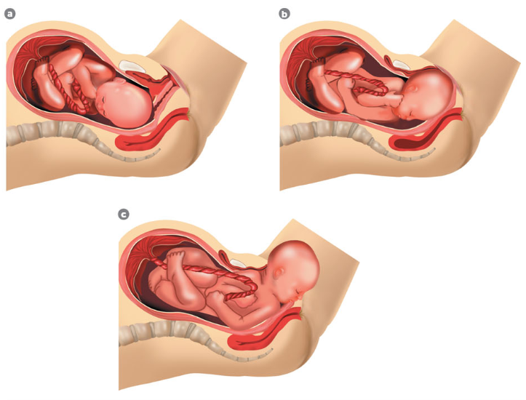

Slide 57
Changes during birth
Third stage of labour: Once born, the baby begins to breath with its own lungs, even when still connected to the placenta via the umbilical cord.
The umbilical cord is clamped and cut. After a few days the stump of the cord dries up and falls away, leaving the navel.
About 5 minutes after birth the placenta, membranes and the remains of the umbilical cord are expelled as afterbirth.

Slide 58
Changes in the baby at birth
Before birth, the lungs of the foetus do not function. It obtains oxygen from the placenta. After birth, the circulation must change.
During birth, foetal blood is carried to and from the placenta by blood vessels in the umbilical cord. It circulates through the placenta, with about 30% bypassing the liver through a vessel called the ductus venosus, and then into the inferior vena cava. The mother’s liver is serving the needs of the foetus at this time, so it presents no problems.

Slide 59
Changes in the baby at birth
Blood returning to the foetal heart enters the right atrium. From there it can follow several pathways:
Blood may flow into the right ventricle and then to the lungs in the usual way. However, the lungs are collapsed and not functioning at this stage, so they offer considerable resistance to blood flow.
Most of the blood from the right ventricle flows through the ductus arteriosus (vessel that bypasses the lung) to the aorta.

Slide 60
Previous list Continued.
Blood in the right atrium of the heart may flow directly into the left atrium through an oval opening (foramen ovale) between the two chambers. The foramen ovale is located so that most of the blood entering the right atrium goes through it.
This is beneficial, as the blood coming from the placenta is highly oxygenated and can flow to the developing foetal tissues via the aorta very quickly.

Slide 61
Changes at birth
At birth, the newborn needs to be independently functional.
Therefore, it is important that the ductus venosus, ductus arteriosus and foramen ovale close.
The first breath of life is usually triggered by the shock of birth. If not, a slap to the bottom usually works.

Slide 62
Changes at birth continued.
As the lungs expand, they no longer offer the same resistance, so blood flow through the ductus arteriosus begins decrease, eventually only leaving some fibrous tissue in remanent.
As larger amounts of blood return to the heart from the lungs, the pressure in the left atrium increases, forcing the foramen ovale against the wall of the atrium, closing the flap.

Slide 63
Changes at birth continued.
With the cutting of the umbilical cord, blood no longer flows through the umbilical vessels (ductus venosus). It will gradually constrict until it is permanently closed off.
If the foramen ovale fails to close, the baby is born with a ‘hole in the heart’. Surgery can be performed to fix the issue.

Slide 64
Changes at birth continued.
Following its birth, the baby breathes rapidly, at about 45 breaths per minute, for the first two weeks, which then gradually slows.
Likewise, the heart rate is high (125-130 beats per minute), which then gradually slows.

Slide 65
Maintaining a healthy pregnancy
Women can make choices to maintain a healthy pregnancy.
A diet with folic acid (normal cell division and manufacturing of proteins), adequate amounts of calcium (normal bone growth), fluoride in water or tablets (strong teeth), vitamin A (normal growth of cells)

Slide 66
Maintaining a healthy pregnancy
Weight gain is normal during pregnancy.
The average is 0.5kg per week during the second half of the pregnancy. Excessive weight gain is hard to lose after the child is born.
A pregnant woman should exercise regularly. Walking regularly is recommended.

Slide 67
Exposure to teratogens
A teratogen is something that causes physical defects in the developing embryo.
They can include hormones, antibiotics, oral anticoagulants, anticonvulsants, anti-tumour drugs, thyroid drugs, thalidomide, LSD, and marijuana.

Slide 68
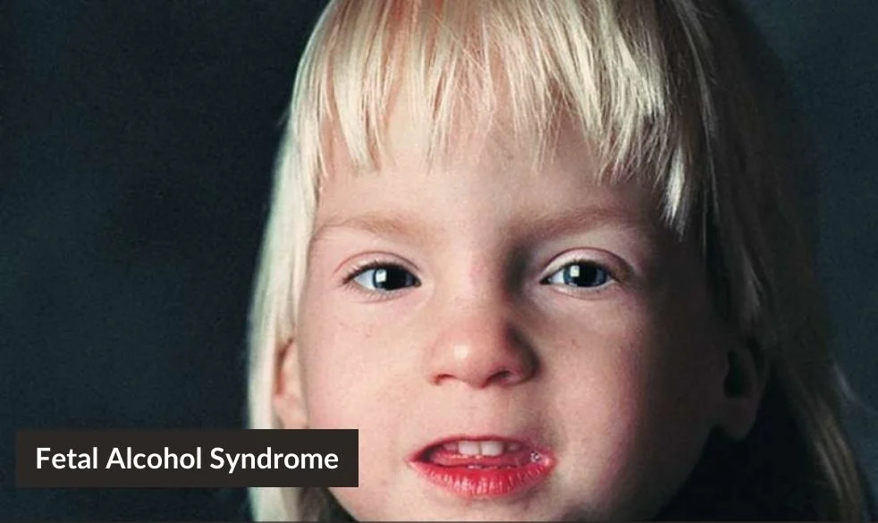
Alcohol
Foetal alcohol syndrome is the term used to describe the effects of foetal exposure to alcohol.
Obvious effects are a lower than normal birth weight, slow growth, a small head, narrow eye slits, sunken nasal bridge, defects of the heart, intellectual disabilities, and behavioural problems.

Slide 69
Smoking
Has adverse effects on the developing foetus.
Birth weight is lower, increased risk of miscarriage, gastrointestinal problems, respiratory problems, increase in sudden infant death syndrome.

Slide 70
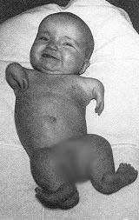
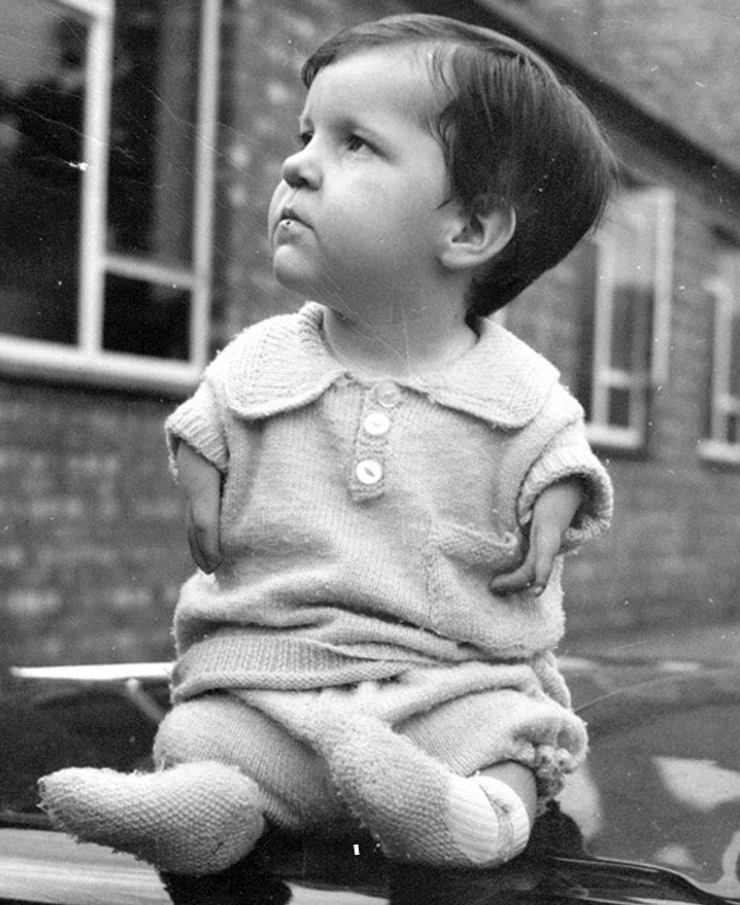
Chemicals
Many chemicals are teratogenic agents.
E.g. thalidomide was an ingredient used in sleeping pills as well in morning sick medication.
Two years after it went on sale in 1958, a sharp rise in the incidence of limb malformations. It was taken off the market in 1961, but at least 7000 babies had been affected.

Slide 71
Other Drugs
Illegal drugs such as heroin and LSD, as well as many other drugs, can cause foetal damage.
The likelihood of birth defects increases as well as miscarriage.
Babies can be born addicted to drugs like heroin.

Slide 72
Rubella
Viral infection that has a higher incidence in school-aged children. If contracted by a pregnant woman it can led to the baby being born deaf, blind, or with heart malformations.
90% of babies will suffer from deafness, blindness, heart defects or brain damage if they are infected in the first 10 weeks of pregnancy.

Slide 73
Recall Knowledge
How does sperm move through the female reproductive tract?
List the functions of the amniotic fluid
List the reasons for increased urination during pregnancy
Define teratogen and foetal alcohol syndrome

Slide 74
Apply Knowledge
Why are a large number of sperm needed for fertilisation?
Use a flow chart to summarise the birth process.
Why should pregnant woman have to make lifestyle choices?

Slide 75
Homework
Create a summary/timeline of events from conception to birth.

Slide 76
Reading
Pages 303- 327: Reproduction produces offspring

